Slide 1
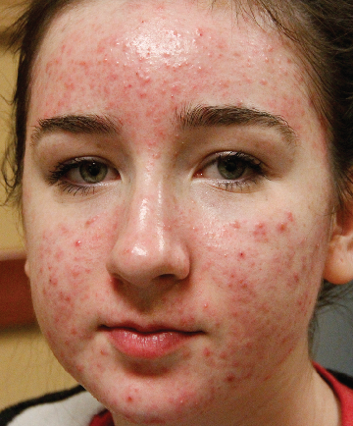
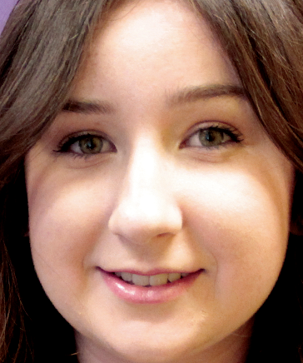
BEFORE / AFTER | One month post 9 tx | courtesy of Brooke Bangart, National Laser Institute
Forever Clear BBL™
Parameters: 1st pass 420 nm filter, 5 J/cm², 150 ms, 50% overlap, 15 °C cooling, 2 passes
2nd pass 560 nm filter,15 J/cm², 180 ms, 50% overlap, 15 °C cooling, 3 passes
© 2016 Sciton, Inc. All rights reserved. 2600-035-78 Rev. B B&A Forever Clear BBL

